Slide 1
Exit Orientation

Slide 2
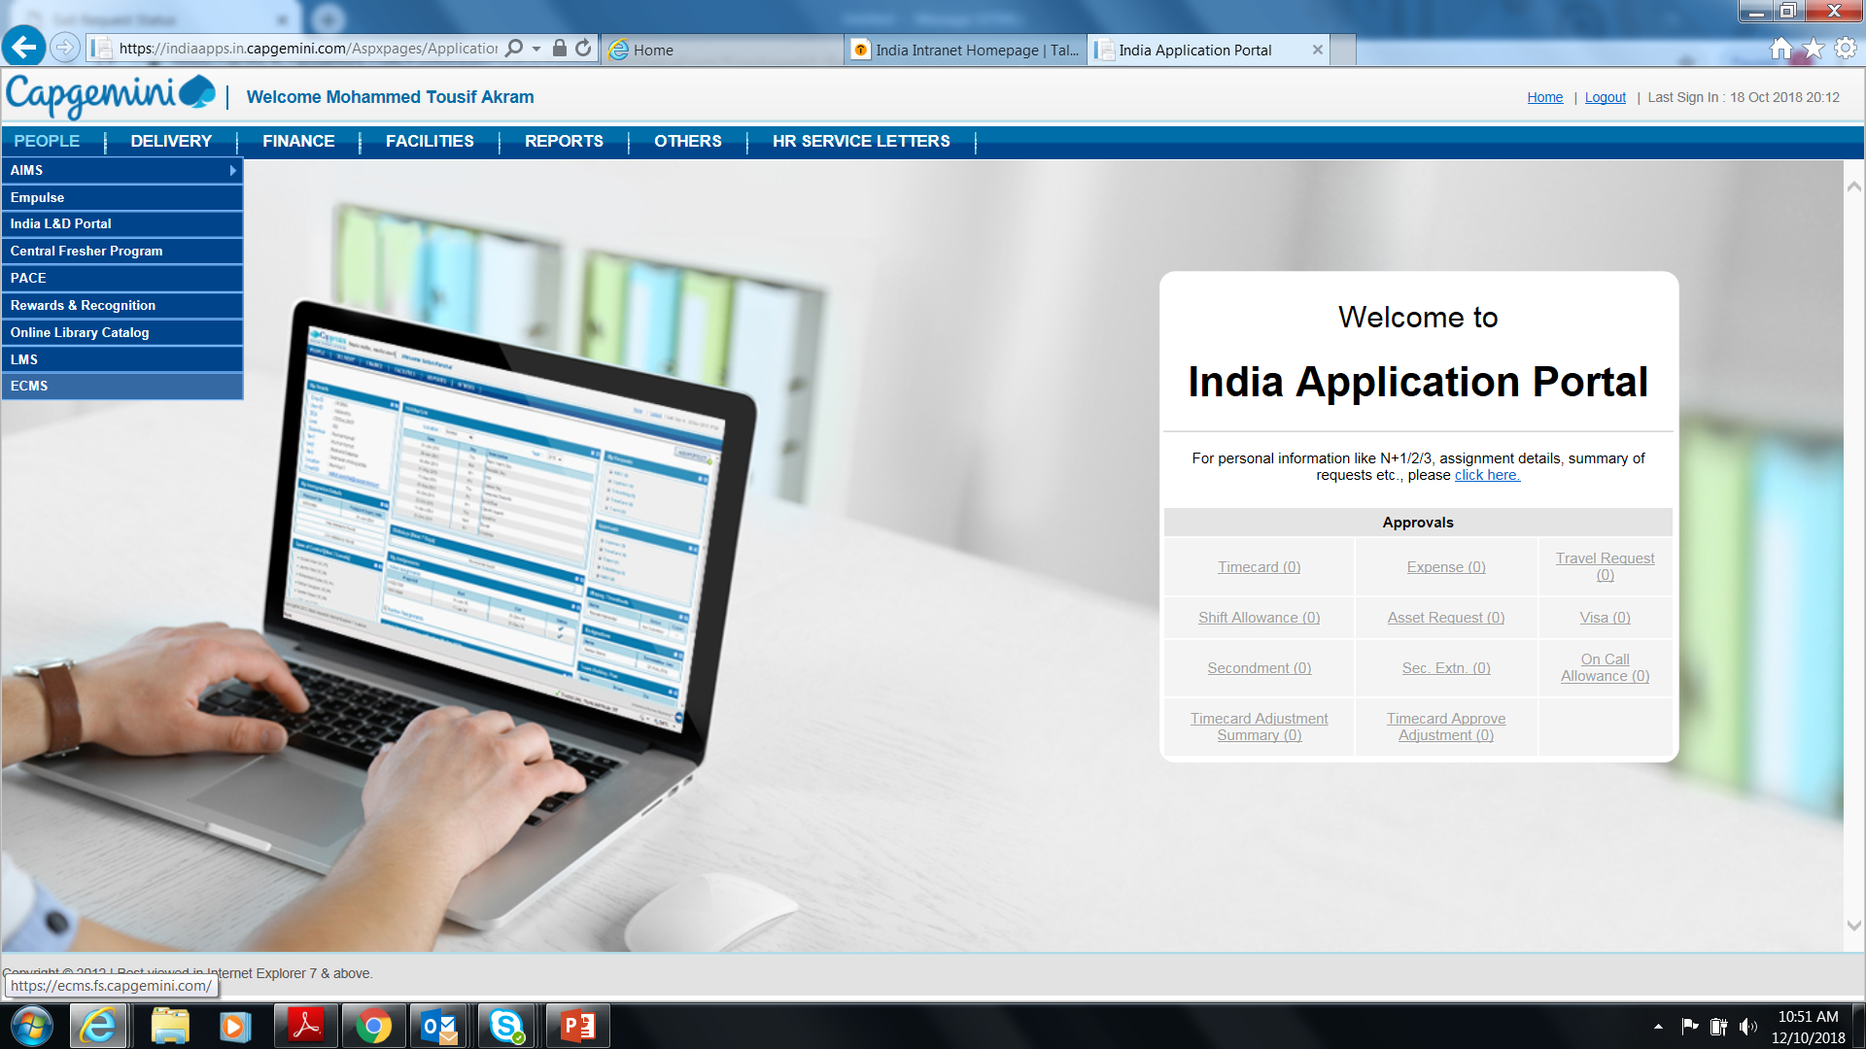
Login Procedure
Step 1: Go to Capgemini talent page link: https://talent.capgemini.com/in
Step 2: Please click on India Application Portal under Helpdesk & Support
Step 3: Once you login to India Application portal, you will be able to view the page as shown below
*Exit Clearance Management System can also be accessed through: https://ecms.fs.capgemini.com/
Click
ECMS

Slide 3
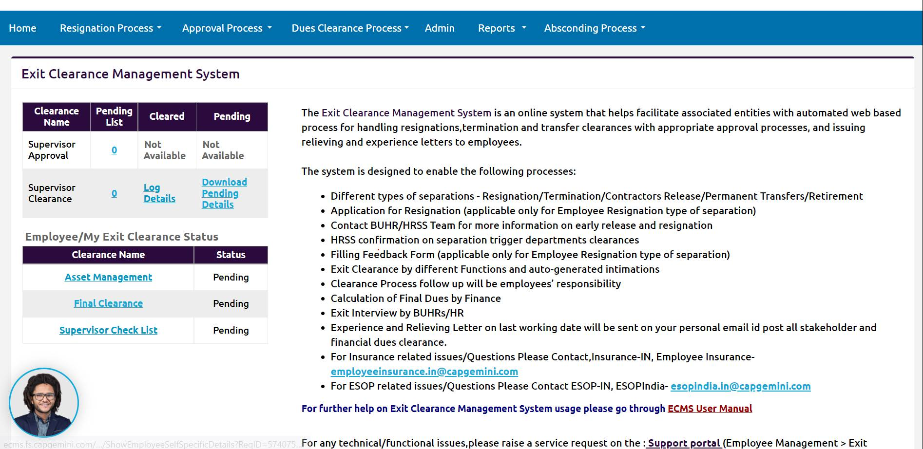
ECMS Home Page

Slide 4
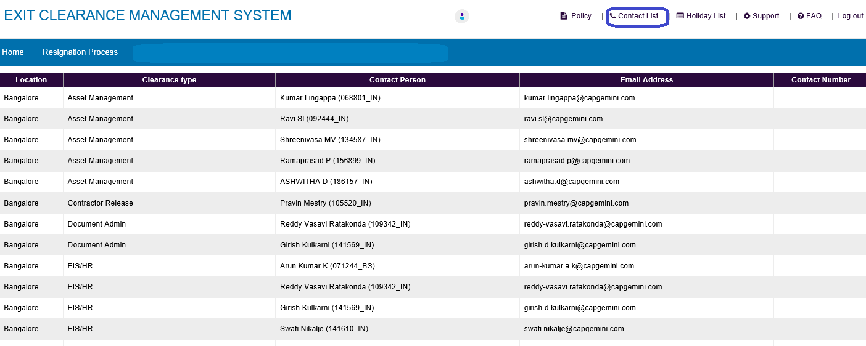
Key Notes - Exit Clearances
Go to Resignation process -> My Information tab and your Validate / Update your Personal email Id & Contact details as the same is used in future
ECMS Home Page – Resignation Tab – My Information
SPOC list details : ECMS Home Page – Top right – Contact List
Notes:
Fixar a posicao do titulo – sempre do lado esquerdo.
Sempre que tiver muito texto o coluna deve sempre ser “ narrowed” , se nao fica dificil de ler. Colocar paragrafos no texto.
Linha vertical deve ser mais fina e as pontas NUNCA devem ser arredondadas.

Slide 5
List of Exit Clearances & Scope
Sequence | Clearance Name | Clearance Completion Scope
1 | Asset Management Clearance | IT Asset Clearance will be provided upon receiving the IT Asset.
2 | EIS/HR Clearance | This will be auto approved 2 days prior to the LWD for the employees serving complete 90 days of notice period. In case of not serving complete notice period, clearance will be provided on LWD
3 | Supervisor Clearance | Supervisor clearance should be done by the respective supervisor before the LWD, post last 6 months timesheets are approved until their LWD
4 | Finance Clearance | Finance clearance will be provided 7 days before the LWD
5 | ICRES Clearances Chair Recovery | Clearance will be provided on the LWD upon receipt of ID card. If the ID/access card does not reach to the base location which will results into recovery of Rs 500/- each Employees who are not having company provided chair it will get auto cleared. If chair has been provided from the company clearance will be provided by HRSS SPOC with recovery status. In case of recovery, employee needs to settle this amount
6 | Amex Card | Employees who are not having Amex card( less than grade D) will get auto cleared post triggerance of clearances. Employees who are having Amex card, clearance will be provided by Amex team based on outstanding amount status
7 | Learning and Development | This clearance will get auto cleared post triggerance of clearance for the employees who are not having any dues. If any employee is having recovery, it will be provided by L&D SPOC on or before LWD as recovery, post which employee needs to settle this amount . Service agreement is also part of L&D dues for applicable employees
8 | People Process /HR | This clearance will get auto cleared 2 days prior or on your LWD subjected to completion of supervisor and time helpdesk clearances, in case of non approval , Auto clearance will be done on your LWD
9 | Car Lease Clearance | Employees who are not having company provided car it will get auto cleared post triggerance of clearances. If car has been provided/taken from the company clearance will be provided by HRSS SPOC post checking recovery status. In case of recovery, it will not be adjusted against F&F as of now
10 | Time Helpdesk | This clearance will get auto approved on LWD
11 12 | Mobility Clearance BUHR Clearance | Employees who are not having valid visa or work permit clearances will get auto approved post triggerance of clearances. In case of any valid visa , Mobility SPOC will connect and complete clearances BUHR clearance will be provided on LWD by respective BUHR
Notes:
Fixar a posicao do titulo – sempre do lado esquerdo.
Sempre que tiver muito texto o coluna deve sempre ser “ narrowed” , se nao fica dificil de ler. Colocar paragrafos no texto.
Linha vertical deve ser mais fina e as pontas NUNCA devem ser arredondadas.

Slide 6
Asset Management Clearance
IT Asset Clearance will be provided only post submission of assets. Assets can be submitted in the base location or the nearest DTA locations(details in the next slide)
Transfer of asset (desktop/laptop) is not allowed and recovery will be applied if the asset is in damaged condition
To raise PC /laptop Surrender request:
Once you raise resignation in ECMS, your surrender ticket will be created automatically for office drop 3 days prior to last working day.
If employee want to surrender asset early before ticket is created, they can do it by raising surrender request manually.
In case early release i.e. within next 7 days from the LWD employee have to create ticket manually by following below path
Please Login below portal.
httpsservicecentral.capgemini.com/sc -> Order or Request -> PC Surrender
Note:
Please visit Capgemini office between 09:00 to 17:00 from Monday – Saturday
Clearance will be provided within 24-48hrs post submission.
Helpdesk contact number:
Email: ithelp.global@capgemini.com
Phone (internal): 484357; Phone (external):+91 226 755 7744
Web: https://servicecentral.capgemini.com/sc
To know tagged Asset & Asset Allocated location details:
Please login into below URL, please surrender accordingly:
https://servicecentral.capgemini.com/myassets_home.do?sysparm_view=MyCompanyAssets
For any asset related queries, send an email to asset SPOC’s mentioned in ECMS.
Notes:
Fixar a posicao do titulo – sempre do lado esquerdo.
Sempre que tiver muito texto o coluna deve sempre ser “ narrowed” , se nao fica dificil de ler. Colocar paragrafos no texto.
Linha vertical deve ser mais fina e as pontas NUNCA devem ser arredondadas.

Slide 7
Employees can surrender the laptop to the nearest DTA Capgemini offices for all locations & at Bhubaneswar and Gandhi Laptops are to be surrendered at the STPI Capgemini office
OU | Unit Details | City | Address | Status | Entity
INH2 | EPIP Campus Non STPI Unit | Bangalore | Ground Floor, Plot Nos. 158-162P and 165P-170P, Sy.No. 7,8,20,22 &23, EPIP Industrial Area, Kundalahalli Village, Whitefield, Bengaluru-560066. | DTA Unit | CG
INC3 | JSS Business Park | Bhubaneshwar | E11/1 ana E11/2, JSS SOFTWARE TECHNOLOGY PARK,, | STPI Unit | CG
 |  |  | Chandrasekharpur, Infocity Campus, Khordha, Odisha, 751024
INA2 | Chennai | Chennai | 8th and 9th Floor, Prestige Cyber Tower, 117, Old Mahabalipuram Road, RoadKarapakkam, Tambaram, Kancheepuram, Rajiv Gandhi Salai, Chennai - 600 097 | DTA Unit | CG
INH7 | Aricent Hanudev Infopark , Coimbatore | Coimbatore | ‘C’ Block, 7th Floor, Hanudev Infopark Pvt. Ltd. 558/2, Udaiyampalayam Road, Nava India, Coimbatore - 641028 | DTA Unit | Aricent
INJ2 | Fintech One Block 53 | Gandhinagar | 12th and 13th floor, Block No. 53, Fintech Bldg. No. 53C, Road No. 52, Zone 5, Village Ratanpur, Palaj, Gandhinagar, Gujarat, 382355 | STPI Unit | CG
INH4 | 5th Floor , Enkay Centre, NH 8, Gurgaon 122016 | Gurgaon | NH 8, Udyog Vihar Phase V, Plot no A, Vanijya Nikunj, Enkay Centre, 5th floor, Gurgaon, Gurugram, Gurugram, Haryana, 122016. | DTA Unit | CG
INH3 | Gachibowli Campus - Non STPI Unit | Hyderabad | SB1 2nd floor, IT Park, Plot No 115/32 and 35, Nanakramguda, Gachibowli, Rangareddy, Telangana - 500032 | DTA Unit | CG
ING3 | Capgemini Technopolis | Kolkata | Awfis Space Solutions, Technopolis, 11th Floor, BP Block, Sector V, Bidhannagar, Kolkata, West Bengal 700091. | DTA Unit | CG
INH6 | Godrej & Boyce- Non STPI Unit | Mumbai | Mumbai-4 Plant 5, Godrej & Boyce manufacturing Limited, | DTA Unit | CG
 |  |  | Pirojshanagar,LBS Marg, Godrej Gate No-2, near vikhroli bus depo, Vikhroli (West), Mumbai- 400079
INH5 | KB Noida Sec 62 | Noida | 7th floor, Tower A - Knowledge Boulevard, Sector 62, Noida – UP 201309 | DTA Unit | Aricent
INH1 | Pune Talawade Non STPI Unit | Pune | Ground Floor, Plot No. A-1, Technology Park, MIDC, Talawade, Pune. Maharashtra - Pune 411062. | DTA Unit | CG
INH9 | Salem | Salem | 41/52, PT Towers, Ground to 3rd floors, 3 Roads, Suramangalam Road, South Lane, Salem, Tamil Nadu, 636009. | DTA Unit | CG
INH8 | Trichy | Trichy | 2nd, 3rd and Terrace Floor, VRN Centre, 37 Bishop Road, Puthur, Trichy, Tiruchirappalli, Tamil Nadu, 620017 | DTA Unit | CG

Slide 8
ICRES Dues Clearance
ID card needs to be submitted by all employees on or before your LWD.
If the ID/access card does not reach the office on or before your LWD there would be a charge of
Rs. 500/- each
ID/access card should be submitted to the ID card cell at their respective base locations
AMEX Card
Clearance will be given 74 days before LWD for employees who are not holding Corporate AMEX Card
Employees holding Corporate AMEX Card and having any dues are requested to get in touch with the Amex(travel) team & ensure dues are settled post which clearances will be provided.
Note: To speed up the clearance process, kindly share the screen shot of payment details with Amex help desk team.
APAC, Amex Help amexhelp.apac@capgemini.com
Notes:
Fixar a posicao do titulo – sempre do lado esquerdo.
Sempre que tiver muito texto o coluna deve sempre ser “ narrowed” , se nao fica dificil de ler. Colocar paragrafos no texto.
Linha vertical deve ser mais fina e as pontas NUNCA devem ser arredondadas.

Slide 9
Finance Due Clearance - Forex
Please connect with Finance SPOC 7 days prior to your last working day
Forex:
If you have any Onsite travel you need to get in touch with forex team to verify your record by providing them your relevant documents like
LOA
Per Diem Annexure Form
Passport Immigration along with stamps having your travel period mentioned in it or else Project Manager’s e-mail approval
Please get your record verified with forex team in case you have claimed Travel Kit Allowance or Relocation Cost.
The same is not applicable for employees on Transfer.
Notes:
Fixar a posicao do titulo – sempre do lado esquerdo.
Sempre que tiver muito texto o coluna deve sempre ser “ narrowed” , se nao fica dificil de ler. Colocar paragrafos no texto.
Linha vertical deve ser mais fina e as pontas NUNCA devem ser arredondadas.

Slide 10

Finance Due Clearance - Payroll
Important Points to Remember:
Clearance
Ensure that all the other teams have given their clearance.
Any delay in clearance by other teams, will have impact on your final settlement.
Final settlement will be released within 30 days from the last clearance date (Not Date of leaving)
Payroll team will start working on your Settlement post final clearance from HRSS exit team .
Leave Encashment Days
Do check your leave balances with HR team at the time of HR clearance.
Leave encashment payout will happen based on leave balances mention in ECMS under HR clearances tab
Submission of OAAR & Investment Proofs
Submit your OAAR claims and Investment Proofs, if any, into HGS Portal before 3 days prior to your last working day
Proof submitted on emails will “Not be Accepted” for Final Settlement
Payment to Company towards Joining Bonus, Retention Bonus, Notice Pay
Employees are required to settle the Joining Bonus, Retention Bonus, Notice Pay upfront
Exit team would be sharing the Company Bank Details for transferring the funds
Employee to do Online transfer and share the screenshot with Exit Team for their Clearances.
These recoveries will not be adjusted against the Full & Final Settlement
Notes:
Fixar a posicao do titulo – sempre do lado esquerdo.
Sempre que tiver muito texto o coluna deve sempre ser “ narrowed” , se nao fica dificil de ler. Colocar paragrafos no texto.
Linha vertical deve ser mais fina e as pontas NUNCA devem ser arredondadas.

Slide 11

Finance Due Clearance - Payroll
Important Points to Remember:
Any Other Allowance
If you are eligible for any other allowances like shift/on-call allowance etc…, Please ensure that your Manager has uploaded and approved the same into PICS tool before your last working day
No Manual inputs will be accepted
HGS Login Credentials
Reset your HGS Password before moving Out.
You can access the HGS Portal even after leaving CG and access will be retained for you for the period 2 years.
HGS Portal view for you will be on read only mode , You can download Pay slips and Form 16 for past periods for your records
External link to access HGS Portal >> https://ess.hgsbs.com/login?company=CG
If you forget password after leaving the organisation, you can still reset it after clicking forgot password option. Temporary password will be sent by HGS to your personal Email id updated by you in ECMS tool. Please ensure that you mention the correct personal E mail id to get all future notifications
DO NOT FORGET AND ENSURE THAT TO SETUP YOUR PASSWORD OF HGS PORTAL BEFORE YOU LEAVE CAPGEMINI
Update Personal Information in ECMS tool
Once the Form 16 is generated, it would be shared to the personal email ID mentioned in ECMS tool.
Notes:
Fixar a posicao do titulo – sempre do lado esquerdo.
Sempre que tiver muito texto o coluna deve sempre ser “ narrowed” , se nao fica dificil de ler. Colocar paragrafos no texto.
Linha vertical deve ser mais fina e as pontas NUNCA devem ser arredondadas.

Slide 12

Finance Due Clearance - Payroll
Important Points to Remember:
Tax treatment on Notice Period Recovery
Notice period recovery will be treated as a deduction as part of your Full & Final settlement.
This will not be reflecting in Form 16 and No income tax benefit.
There is no provision available in Income Tax Act for exempting the Notice pay recovery against your Income
Notice Pay Recovery Calculations >> Salary * Number of Days Recoverable / 365 days
Salary includes Basic, HRA, OAAR 1, OAAR 2 and Statutory Bonus components.
Tax treatment on Joining / Retention Bonus Recovery
Financial Year (FY - 01 April to 31 March)
If the payment and Recovery of Joining / Retention Bonus happens in the same Financial Year, then we shall pass on the Income tax benefit by reducing your taxable income
If the payment and Recovery of Joining / Retention Bonus happens across two different Financial Year than the deduction of recovery is passed on in the next Financial Year.
e.g. if payment is made in the Financial Year 2022-23 the same will appear as taxable income in your form 16 and tax will deduct accordingly
If Resignation and settlement happens during the Financial Year 2023-24 , the recovered amount is shown as a negative value in your Tax statement and your total income is reduced for tax to that extent, effectively the tax benefit is passed to you in subsequent Financial Year
Notes:
Fixar a posicao do titulo – sempre do lado esquerdo.
Sempre que tiver muito texto o coluna deve sempre ser “ narrowed” , se nao fica dificil de ler. Colocar paragrafos no texto.
Linha vertical deve ser mais fina e as pontas NUNCA devem ser arredondadas.

Slide 13
Finance Due Clearance - Payroll
Important Points to Remember:
Gratuity Payment
Gratuity payment will not be part of Full & Final settlement.
This will be paid separately from the Gratuity Trust (Handled by Retirals Team)
You would be receiving a separate Form 16 for Gratuity Payment.
Leave Encashment Payment & Tax exemption
Maximum leave encashment payable is 30 days as per company policy
Leave Encashment Calculations
Salary * # of Leave Days / 365 Days in a Year
Salary includes Basic, HRA, OAAR 1, OAAR 2 and Statutory Bonus components
Leave encashment is not fully exempted as per Income Tax Act. The Tax exemption is calculated in based on IT based on below guidelines and least of the below amount is exempted
Cash equivalent of unutilised earned leave (earned leave entitlement cannot exceed 30 days for every year of actual service).
Last 10 months average Basic salary.
Actual Leave encashment amount received at the time of Resignation
Maximum 3 lac can be calculated for exemption.
Provisional Tax statement / Form 16
Post completion of Full & Final settlement, Provisional tax statement would be shared with you.
You can submit the same with the New Employer for current year taxation purpose.
Form 16 for the year will be generated around May/June next year. The same will be shared with your personal email ID updated in ECMS Tool
Gratuity Form 16 will also be shared separately to your personal email ID
You are required to club both the Form 16s while filing the Income tax returns.
Notes:
Fixar a posicao do titulo – sempre do lado esquerdo.
Sempre que tiver muito texto o coluna deve sempre ser “ narrowed” , se nao fica dificil de ler. Colocar paragrafos no texto.
Linha vertical deve ser mais fina e as pontas NUNCA devem ser arredondadas.

Slide 14
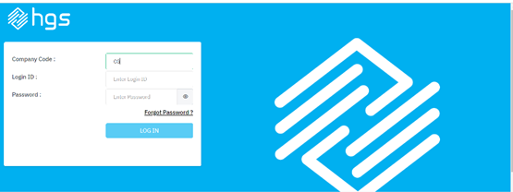
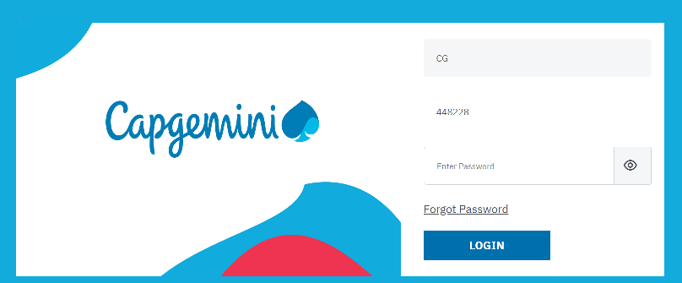
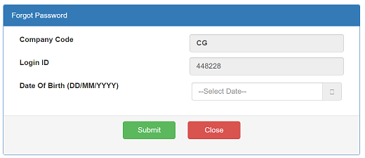
Finance: Payroll portal- Steps to login HGS Portal
https://ess.hgsbs.com/login?company=CG
Step 1: Employee code should be CG (capitals) Step 2: Enter CGGID and click on Forgot password
Step 3: Enter DOB and click on submit button, the new password email will go to Capgemini mail box.
Please note: Please complete the process before your LWD.

Slide 15
Finance: Payroll portal
Please Login HGS Portal. All Documents available on HGS portal for Active & Exit EMP.
https://ess.hgsbs.com/login?company=CG
Form 16
F&F statement
!. Global id:
2) Password - Refer your mail with the subject "WELCOME TO ESS" u will find default password & enter the password which will prompt to u to reset password use chrome or Edge
3) You do not remember password. Skip the 2nd option try 4th option
4) Go to the Forgot password option.
5) New page open fill your DOB & DOJ – New password generated your personal mail id in ECMS Records.
6) Again, go to link https://ess.hgsbs.com/login?company=CG
7) Global ID –
8) Password – (please fill you receive forgot password)
9) New page (Change password) open
10) Current password – is you receive (Forgot Password)
11) Create new password & confirm password
***Please note: Password to Open Form 16 for FY 21-22 is your PAN in capital
Make sure you update your personal mail id on ECMS application and My connect portal
Please note your final settlement statement Pay slip with IT computation sheet has been updated on the HGS Portal under Reports.
You can access the HGS portal using the below link: https://ess.hgsbs.com/login?company=CG
Login Id: Your Global ID
Password:
If you forget your password, please login with your Global Id mentioned in subject line and click on forget password

Slide 16
Finance Due Clearance - Payroll
Important Points to Remember:
Please send all your F&F related queries to the below Email ID :
fnfhelpdesk.in@capgemini.com
Escalations Matrix
If your queries not answered in 3 working days , Below are the escalation Matrix , Please reach out to below .
Level 1 -
S, Ganesh ganesh.a.s@capgemini.com
Level 2 -
Krishnan Kutty, Praveen praveen.kutty@capgemini.com
Leven 3 -
Mohan Saxena, Shyam shyam.saxena@capgemini.com
Notes:
Fixar a posicao do titulo – sempre do lado esquerdo.
Sempre que tiver muito texto o coluna deve sempre ser “ narrowed” , se nao fica dificil de ler. Colocar paragrafos no texto.
Linha vertical deve ser mais fina e as pontas NUNCA devem ser arredondadas.

Slide 17
Mobility Clearance
Clearance can be completed 7 days before last working day if you do not hold any visa’s
Please get your record verified with International Mobility team, in case you hold valid Work Permit / Visa / Residence Permit Card
For any queries or clarification, please contact country specific spoc from International Mobility team: Contacts | Talent Capgemini:
https://talent.capgemini.com/in/pages/supportfunctions/human_resources/India_International_Mobility/contacts
For further queries related to ECMS clearance status, send an email to:
ecmsclearance_internationalmobility.in@capgemini.com
Notes:
Fixar a posicao do titulo – sempre do lado esquerdo.
Sempre que tiver muito texto o coluna deve sempre ser “ narrowed” , se nao fica dificil de ler. Colocar paragrafos no texto.
Linha vertical deve ser mais fina e as pontas NUNCA devem ser arredondadas.

Slide 18
Final Clearance
Final Clearance applicability:
It will be auto approved on the last working day post completion of all clearances subjected to no recovery
In case of recovery, employee has to settle the dues, post confirmation on the amount credited, Final clearance will be provided
Once final clearance is completed, relieving & experience letter would be auto generated & triggered to the employee, subjected to no dues towards any departmental clearance
Digital letters with digital signature will be released to employee’s personal mail id within 24 hrs from Final Clearance completion
In case of any departmental dues, if employee fails to pay within 3 working days post intimation, then final clearance will be closed & letters will be on hold until FnF completion
Once F&F is completed,
If the settlement amount is positive, then letters will be released
If the settlement amount stands negative, post payment from the employee and confirmation of credit, letters will be released.
The mode of payment would be online transfer(NEFT & RTGS only).
Bank details are available in the next slide.
For Payment related query, please reach out to Central Exit team at
centralexit.in@capgemini.com
Notes:
Fixar a posicao do titulo – sempre do lado esquerdo.
Sempre que tiver muito texto o coluna deve sempre ser “ narrowed” , se nao fica dificil de ler. Colocar paragrafos no texto.
Linha vertical deve ser mais fina e as pontas NUNCA devem ser arredondadas.

Slide 19
Bank Details
Fund Transfer type : NEFT only
Amount: Rs._______/-
Beneficiary Name: Capgemini Technology Services India Ltd.
Bank Name : BNP Paribas
IFSC : BNPA0009009
Bank Address : BNP Paribas House, 1 North Avenue, Maker Maxity, Bandra Kurla Complex, Bandra East, Mumbai 400 051
Bank Account Number : CAPGEMEXITEMPLOYEE ID NUMBER
Account Type : Current account
Note: Bank Account number is combination of “CAPGEMEXIT” fix words, without space, adding Employee Number.
Below are the scenarios -
If Natasha is having her Employee ID 001234 then account number is CAPGEMEXIT001234
If Natasha is having her Employee ID 012345 then account number is CAPGEMEXIT012345
If Natasha is having her Employee ID 123456 then account number is CAPGEMEXIT123456
If Natasha is having her Employee ID 12345678 then account number is CAPGEMEXIT12345678
Please note once you make payment before 6 PM of the day we shall be able to check and confirm the receipt of payment next day by EOD & if you make payment after 6 PM of the day then we shall be able to check and confirm the receipt of payment after 2 days.
If we do not receive any response or payment within 3 working days, we shall close your case for FFS which will take 30 days and letters will be released post that if amount will be
positive.
Notes:
Fixar a posicao do titulo – sempre do lado esquerdo.
Sempre que tiver muito texto o coluna deve sempre ser “ narrowed” , se nao fica dificil de ler. Colocar paragrafos no texto.
Linha vertical deve ser mais fina e as pontas NUNCA devem ser arredondadas.

Slide 20
Bank Details
Capgemini Technology Services India LTD
Altran Technologies India Pvt Ltd:
GLOBAL EDGE SOFTWARE LTD
Account Name | Capgemini Technology Services India LTD.
Bank Name | BNP Paribas
Bank Account # | CAPGEMEXITEMPLOYEE ID NUMBER
IFSC/SWIFT Code | BNPA0009009
Branch | BNP Paribas House, 1 North Avenue, Maker Maxity, Bandra Kurla Complex, Bandra East, Mumbai 400 051
Account Type | Current Account
Beneficiary Name | Altran Technologies India Pvt Ltd
Bank Name | BNP PARIBAS
Bank Address | EAST TOWERS (SOOD TOWERS), 1ST FLOOR, 25, BARAKHAMBA ROAD, NEW DELHI - 110001
Bank A/c No. | 0906510988200119
IFSC Code | BNPA0009065
Account type | Current Account
BENEFICIARY NAME | GLOBAL EDGE SOFTWARE LTD
BANK NAME | CITI BANK
BANK ADDRESS | MG ROAD, BANGALORE
BANK A/C NO. | 0522597031
IFSC CODE | CITI0000004
ACCOUNT TYPE | CURRENT ACCOUNT

Slide 21
Shift/On-call Allowance:
Those who are close to their LWD, Shift allowance portal will be enabled only 5 days prior to their LWD.
Please note that your attendance and roster are updated on the tool
Please ensure to raise your Shift allowances attendance request and it should be approved by the supervisor.
Roster for on-call allowance should be submitted by the supervisor in the portal. .
It will be processed with your F&F once attendance approved by your supervisor and allowances request approved by the PMO.
Any shift or on-call allowances not claimed via the tool will not be processed
An employee cannot apply for backdated shifts beyond 90 days of original shift.
For Shift Allowance Queries, Please connect with - shiftallowancequery.fssbu@capgemini.com
Internet Reimbursement:
Effective 1st July 2023 onwards, the Internet reimbursement claim is up to the limit of Rs. 500 per month.
Please note internet charges older than 3 months will not be processed as per policy. It is advisable to submit the claim within 30 days from expenditure date.
Please ensure to submit your claims before exits form the company. If any claim submission after relieving , will not be allowed
If you have any internet expense queries, please drop a mail in our generic mail id: financeexp-reimburse.in@capgemini.com
Variable Pay:
Advance variable payout will be recovered in case of employee resigns on or before March 31, 2024

Slide 22

We are pleased to announce the launch of first ever voice based HRSS - Smart Services Desk, the new age solution for our serving notice period employees.
Smart Services Desk is launched with the aim to make sure that all exiting employees have a hassle -free offboarding experience.
Objectives here is to facilitate voice - based support to all our current exiting employees as primary point of contact for any exit queries. Easing the communication for providing quicker resolutions.
Capgemini being a multi-cultural organization, we want to establish a trustworthy connection for the serving notice period employees.
The SSD service is available from Monday to Friday 9 am to 5:30 pm IST, the dial in number 080 66442727/ 080 41834009
You may call them on the number displayed on the ECMS portal or above for any of your exit queries.

Slide 23
Important Points/Contacts
Download payslips, IT Computation Doc from HGS portal at below link:
Link:- https://ess.hgsbs.com/
Full & Final settlement will be completed within 30 days post your final clearance is completed & statement will be shared to your personal mail ID.
For Insurance related queries, please write to Insurance team - employeeinsurance.in@capgemini.com
For ESOP query, please write to esopindia.in@capgemini.com
For any support after exit do write to, offboardingservices.in@capgemini.com
For Ex-Employment Verification please inform your new employer to drop a mail to verification.in@capgemini.com
For Sodexo Card Queries – consumer@india.sodexo.com
For Shift Allowance Queries - shiftallowancequery.fssbu@capgemini.com
For policy or process understanding related query please reach out to your BUHR.
Notes:
Fixar a posicao do titulo – sempre do lado esquerdo.
Sempre que tiver muito texto o coluna deve sempre ser “ narrowed” , se nao fica dificil de ler. Colocar paragrafos no texto.
Linha vertical deve ser mais fina e as pontas NUNCA devem ser arredondadas.

Slide 24
Escalation Matrix -
Process Related Queries – exitorientation.in@capgemini.com
Level 1 – Janardhana Rao janardhana.rao@capgemini.com
Level 2 – Ranjana Bhawsingka ranjana.bhawsingka@capgemini.com

Slide 25
Thank You...
Good luck and best wishes for your future endeavors

